Slide 1

Drivers Impacting the Housing Market in Georgia
Yannik Alinyoh Kevin Balhoff
Tara Flowers Ellie Zhang
Harry Zhang
GT Data Science Analytics Bootcamp – 12
Diversity 101

Slide 2
Background

Slide 3
Overview of Topic
Core Question: What are the primary drivers which impact the median home price in Georgia?
Core Strategy: Look for correlations between median home price and various external factors year over year at the total state level and at the zip code level and see whether they are correlated to increases and decreases in median price.

Slide 4
Summary
As expected, the price of homes in Georgia is increasing year over year across zip codes.
Median income has an impact on the affordability of housing in metro Atlanta.
As population grows, property value increases due to the increased demand in a concentrated area.
Interest rates are rising in Georgia, contributing to rising costs of the affordability of housing.
Zip codes with higher poverty rates in Georgia are less expensive to live in than those with lower poverty rates.
Zip codes with higher unemployment rates in Georgia are less expensive to live in than those with lower unemployment rates.
Zip codes with fewer highly educated people in Georgia are less expensive to live in than those with more highly educated people.
The GDP of Atlanta area has a positive effect on Atlanta’s house price index, the higher a year’s GDP, the higher Atlanta’s HPI.
Many of these factors are intertwined, and a more robust analysis with a more robust data set would be helpful to identify the key factors that are most correlated with home price in an area.

Slide 5
Questions/Data
Questions Asked:
Have home prices increased or decreased over time in the state of Georgia?
Do people in Georgia generally buy more expensive homes if they make more money?
How does the growth in the population affect housing prices in Georgia?
What external factors can impact the price of homes in an area?
Does poverty rate by zip code impact home price?
Does unemployment rate by zip code impact home price?
Does the count of bachelor’s degrees in a zip code impact the housing price appreciation?
Data Needed:
Historical home price data and some demographic data for Georgia was obtained from datausa.io
Some points of interest on historical home price by zip code were collected from Zillow research data
Some demographic data was obtained from the Census API

Slide 6


Roadblocks
Problems Which Arose
Retrieval Limits
Initially, much of our data on the state level and zip code level came from ATTOM real estate APIs.
This left us scrambling for reliable data sources at the end, and we didn’t get the chance to explore as many factors as we initially intended.
Some speed considerations depending on what the volume of data was being requested (frequent timeouts)
Different data sources provided different periods of time, which were at times difficult to combine
Scale
SO MANY factors influence the real estate market!
If we could isolate every single factor and its exact impact on home price in each zip code in ~2 weeks, we would be off exploiting arbitrage opportunities on the real estate market.
Our group aligned on choosing a handful of factors which were readily available to test and see what correlations we saw when comparing to home price over time!
Georgia Tech Wi-Fi

Slide 7
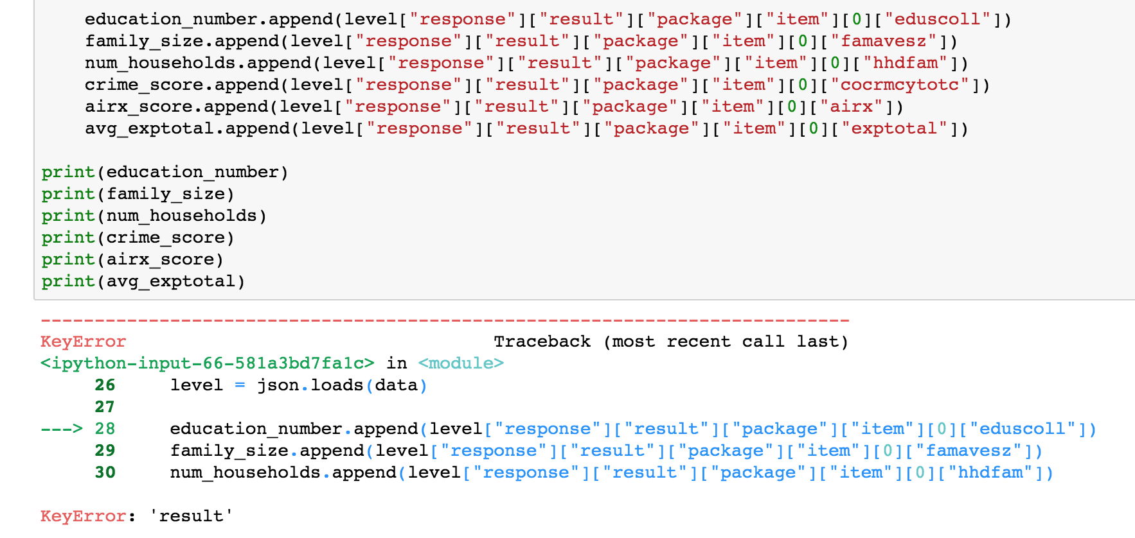
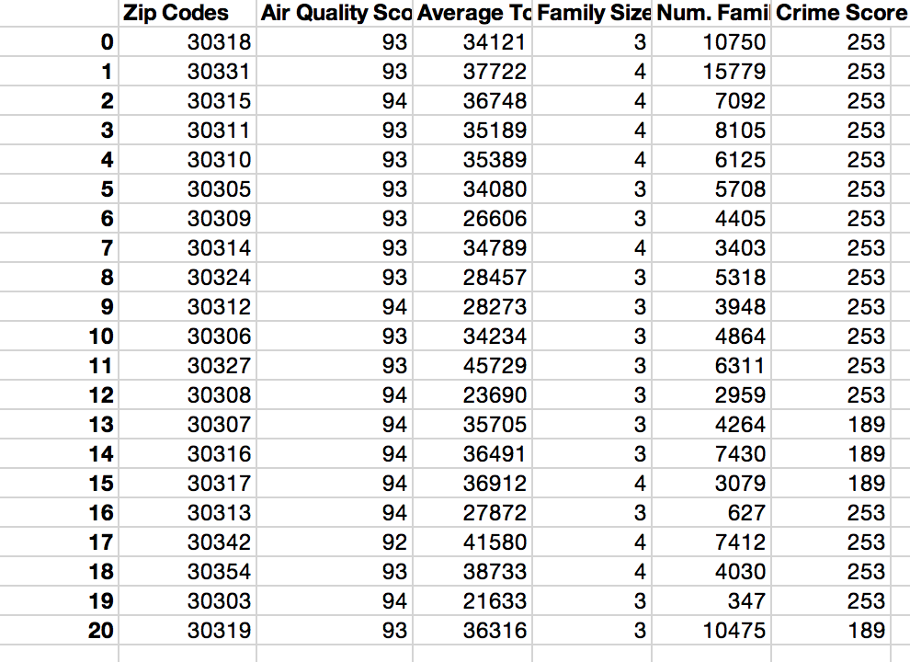
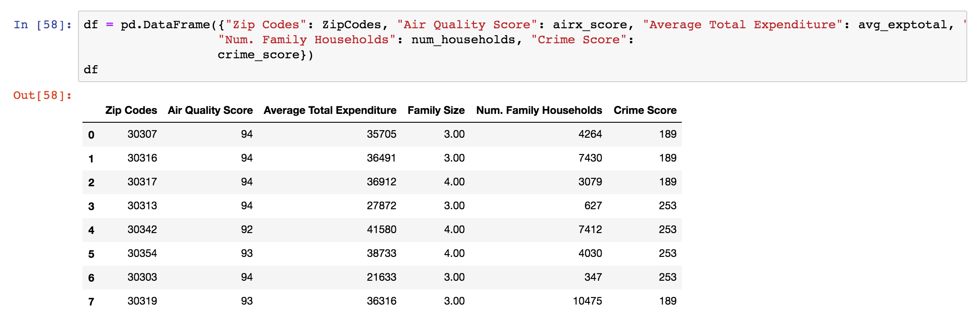
Data Retrieval Process and Result
Six demographic characteristics were screened and identified as possible potential factors to housing prices: education level, family size, number of households, crime score, air quality score, and average expenditure
There are 108 zip code areas in Atlanta, and we were able to extract 7 zip codes/run. The data were stored in an excel file, which we planned to export as csv format and run analyses. Unfortunately, the 21 cases which we were able to pull is insufficient to generate meaningful results

Slide 8
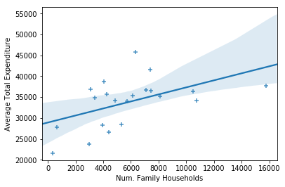
Average Total Expenditure of Family Households in the Atlanta Area
There is a strong positive relationship between the number of family households per zip code with the average total expenditure of each family.

Slide 9
Data Analysis

Slide 10

Data Analysis
Graphical analysis was primarily done with Matplotlib
There were many different ways to visualize our data, and this helped us to view the data from different points of view (scatter plots, line graphs, boxplots, etc).

Slide 11
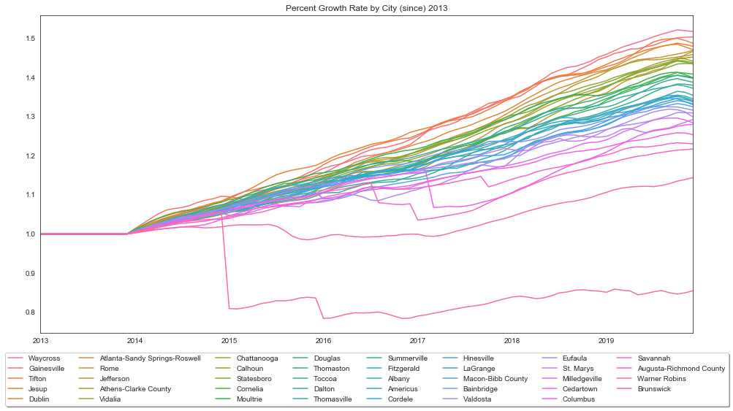
Home Price Trends
Across cities in Georgia, we have seen home price increase steadily over the previous 5 years

Slide 12
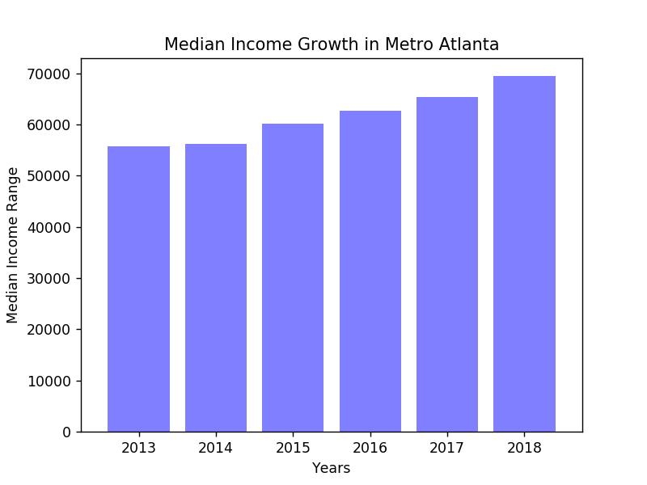
Median Income in Metro Atlanta
Takeaway: Median Income increases year over year in the Metro Atlanta area.

Slide 13
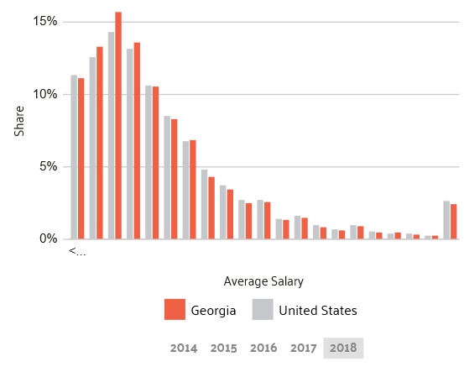
Wage Distribution in Georgia
In 2018:
525,008 people were employed in Georgia earning less than $10k/year
626,248 earned from $10k to $20k
740,762 earned between $20 to $30k.
390,649 people earned between $50-$60K, which contains the median income for Georgia ($58,756).
Only 321,971 people earn $60k-$70k
Based on the population of 10.5 million, the majority of wage earners wouldn't be able to afford to purchase a home if they earn less than $30k per a year and they are a single household income.

Slide 14
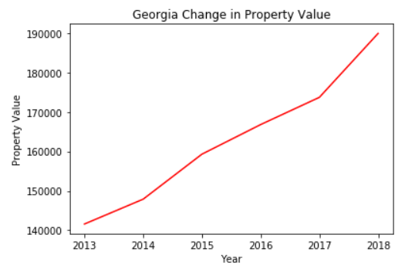
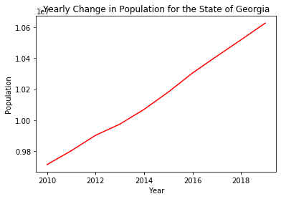
How does the growth in population have an effect on housing prices in the region?

Slide 15
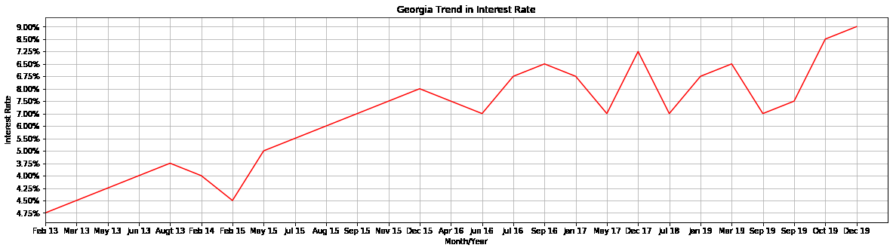
Rising interest rates also have an impact on property value

Slide 16
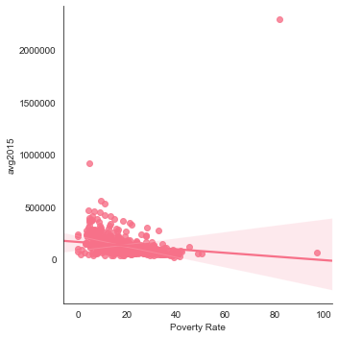
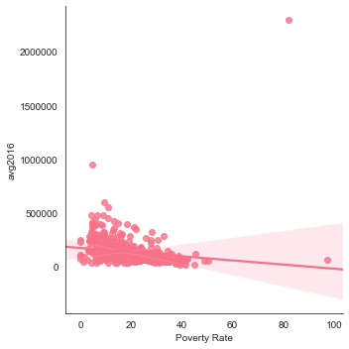
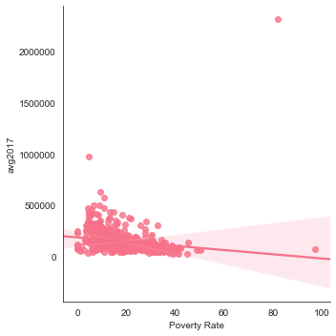
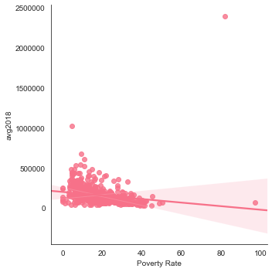
Does Poverty Rate Impact Home Price?
2015
2016
2017
2018
Takeaway: Median home price increases across years when the poverty rate decreases

Slide 17
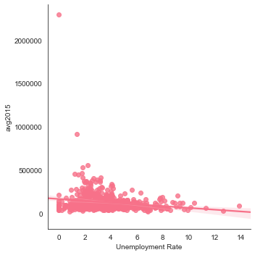
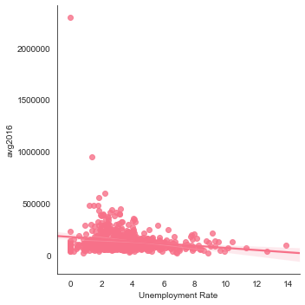
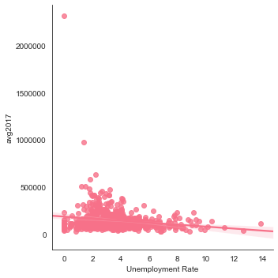
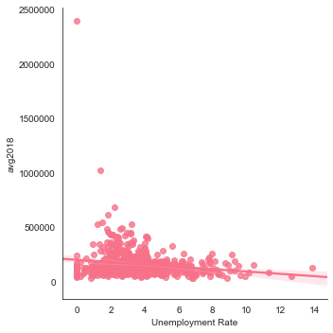
Does Unemployment Rate Impact House Price?
2015
2016
2017
2018
Takeaway: Areas with a higher unemployment rate among homeowners are less expensive to live in than areas with a low unemployment rate among homeowners

Slide 18
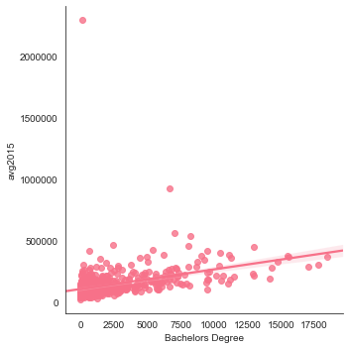

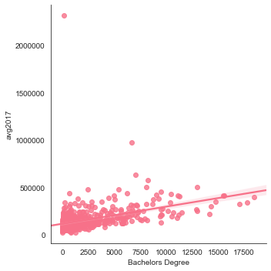
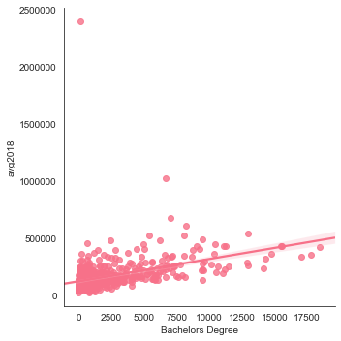
How Does Education Impact The Median Home Prices by Zip Code?
2015
2016
2017
2018
Takeaway: On average, zip codes that contain more people who have completed a Bachelor’s degree are more expensive to live in than zip codes where fewer people have completed a Bachelor’s degree

Slide 19
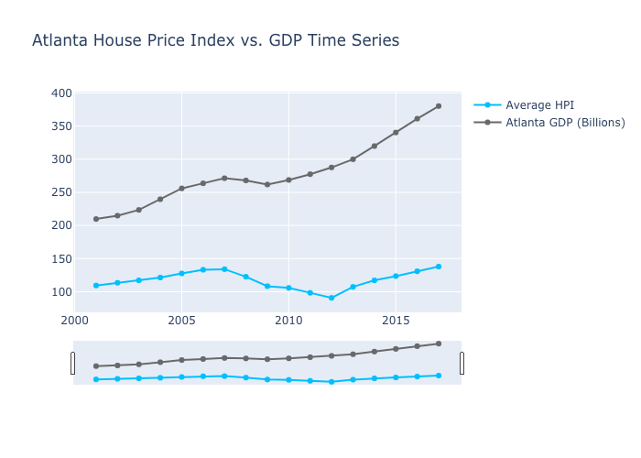
How GDP affects House Price Index

Slide 20
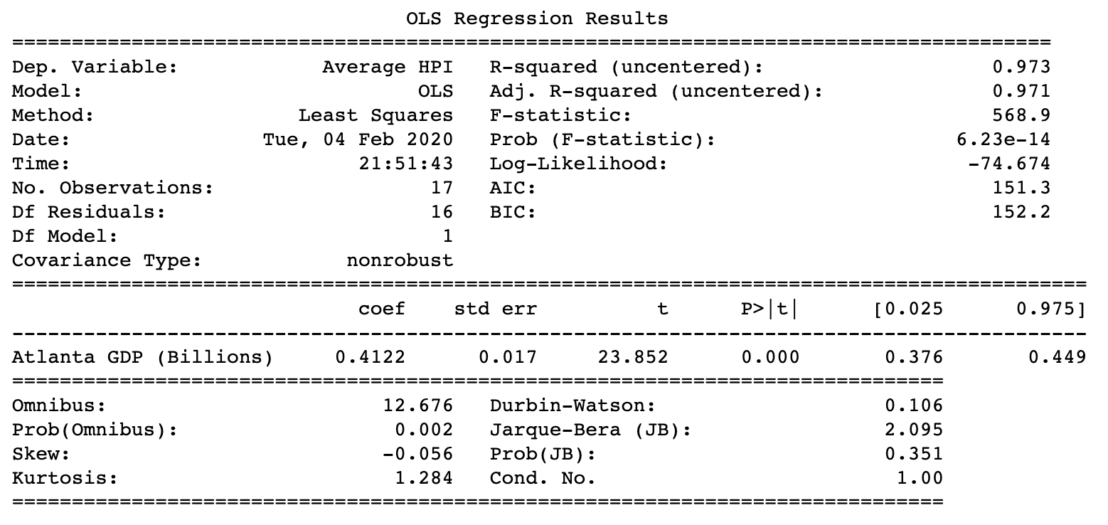
Regression Results

Slide 21
What’s Next?
If we had a few more weeks to investigate…
We’d love to look at how various data points are correlated:
Does count of bachelor’s degrees per capita increase as stronger job opportunities increase?
Does the split of white collar/blue collar job opportunities impact home price?
How do things like commute distances to the city, walking scores, and access to public transportation factor into home price?
Does split of rental opportunities versus “owned” homes impact the median price of sale?
What factors are caused by the increase in median home price and what factors result in an increase in home price?
i.e., do prices move down as poverty rates increase, or vice versa?
Does having more Starbucks Coffee’s or Chipotle’s open in a neighborhood result in the price of rent increasing? Or does Starbucks Coffee and Chipotle select locations that have recently seen a wealthier clientele move in?

Slide 22
Q&A
Thank you!

Slide 23
Appendix

Slide 24
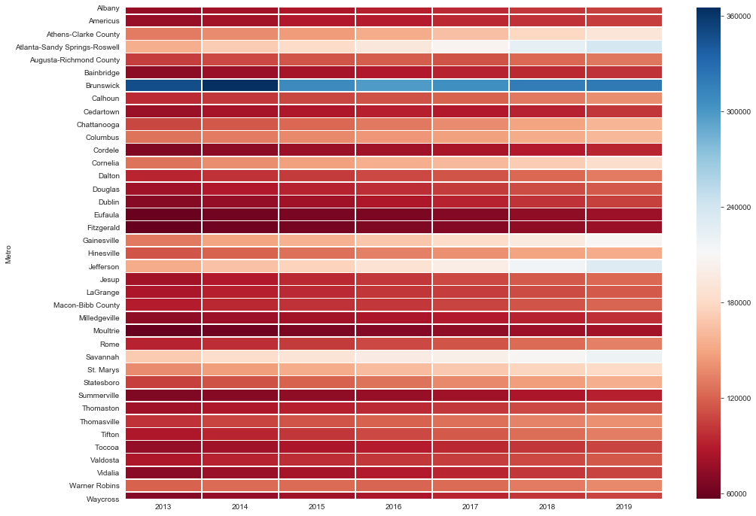
Home Price By City Over Year

Slide 25
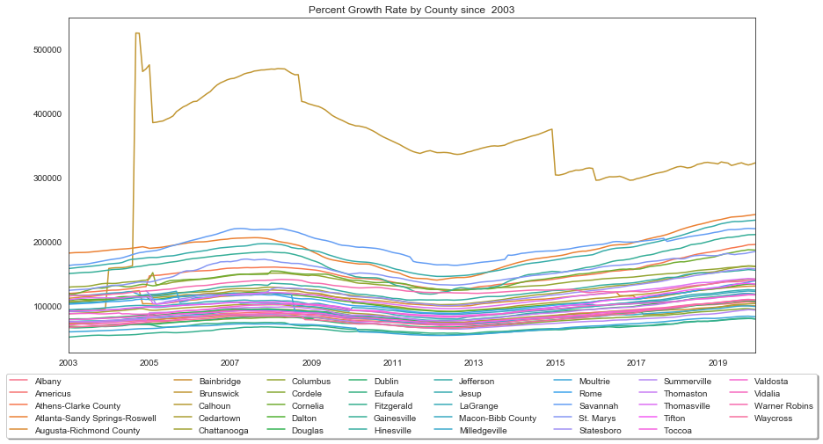
Home Price by County/City – The Economic Decline

Slide 26
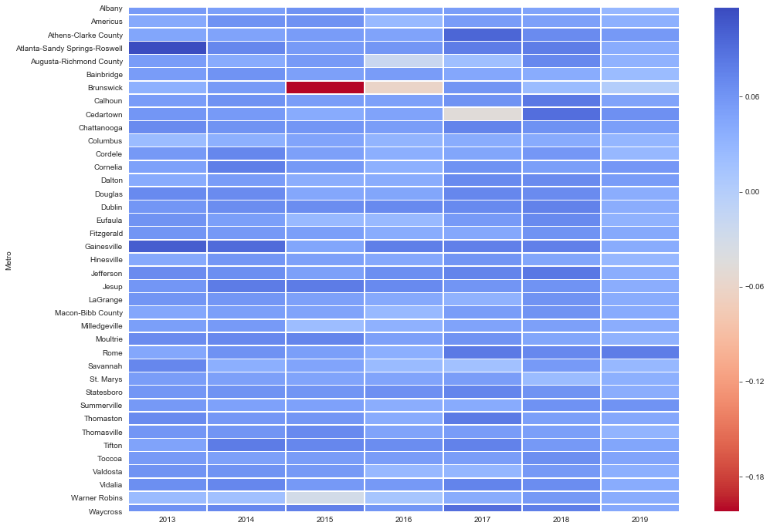
Index of Home Price Year over Year

Slide 27
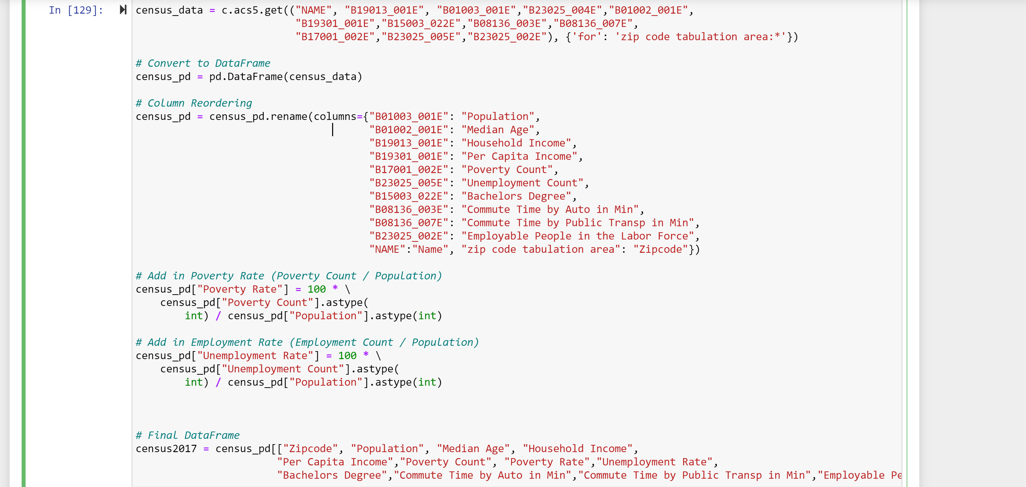
Merging Zillow Data with Census Data

